Slide 1
NIST CSF
為什麼? 重要性?

Slide 2
agenda
Cybersecurity threats
NIST
CSF
Framework
Benefits 用處

Slide 3
Cybersecurity threats

Slide 4
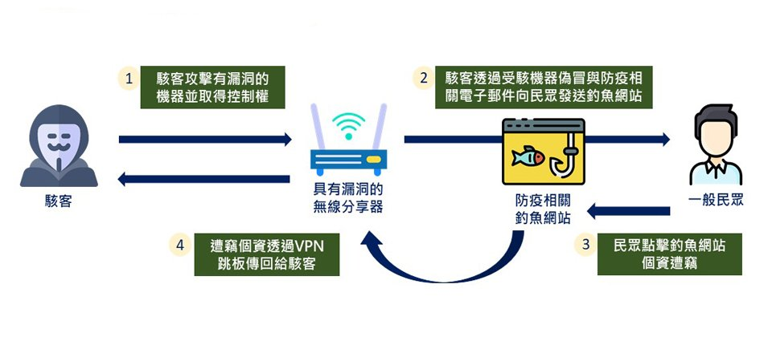

Slide 5
Ransomeware
Ransom malware, or ransomware,
is a type of malware that prevents users from accessing their system or personal files and demands ransom payment in order to regain access.
The earliest variants of ransomware were developed in the late 1980s, and payment was to be sent via snail mail.
Today, ransomware authors order that payment be sent via cryptocurrency or credit card.

Slide 6
IOT security
IoT security is the technology area concerned with safeguarding connected devices and networks in the internet of things (IoT).
IoT involves adding internet connectivity to a system of interrelated computing devices, mechanical and digital machines, objects, animals and/or people. Each "thing" is provided a unique identifier and the ability to automatically transfer data over a network. Allowing devices to connect to the internet opens them up to a number of serious vulnerabilities if they are not properly protected.

Slide 7
NIST

Slide 8
About NIST
The National Institute of Standards and Technology (NIST)
was founded in 1901 and is now part of the U.S. Department
of Commerce. NIST is one of the nation's oldest physical science laboratories. Congress established the agency to remove a major challenge to U.S. industrial competitiveness at the time—a second-rate measurement infrastructure that lagged behind the capabilities of the United Kingdom, Germany, and other economic rivals.

Slide 9
NIST CSF

Slide 10
The Framework is a risk-based approach to managing cybersecurity risk, and is composed of three parts:
the Framework Core,
the Framework Implementation Tiers, and
the Framework Profiles.
1 | the Framework Core
2 | the Framework Implementation Tiers
3 | the Framework Profiles

Slide 11
Framework Core

Slide 12
The Framework Core
represents a common set of activities for managing cybersecurity risk.
No specific order, the importance of each other is the same.
it is extensible, allowing organizations, sectors, and other entities to use Subcategories and Informative References that are cost-effective and efficient and that enable them to manage their cybersecurity risk.

Slide 13
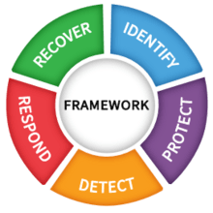
The Framework Core consists of five concurrent and continuous Functions—Identify, Protect, Detect, Respond,Recover
1 | Identify | Develop an organizational understanding to manage cybersecurity risk to systems, people, assets, data, and capabilities.
2 | Protect | Develop and implement appropriate safeguards to ensure delivery of critical services.
3 | Detect | Develop and implement appropriate activities to identify the occurrence of a cybersecurity event.
4 | Respond | Develop and implement appropriate activities to take action regarding a detected cybersecurity incident.
5 | Recover | Develop and implement appropriate activities to maintain plans for resilience and to restore any capabilities or services that were impaired due to a cybersecurity incident.
When considered together, these Functions provide a high-level, strategic view of the lifecycle of an organization’s management of cybersecurity risk.
The Framework Core then identifies underlying key Categories and Subcategories – which are discrete outcomes – for each Function, and matches them with example Informative References such as existing standards, guidelines, and practices for each Subcategory.

Slide 14
1 Identify
ID.AM | Asset Management (ID.AM): The data, personnel, devices, systems, and facilities that enable the organization to achieve business purposes are identified and managed consistent with their relative importance to organizational objectives and the organization’s risk strategy.
ID.BE | Business Environment (ID.BE): The organization’s mission, objectives, stakeholders, and activities are understood and prioritized; this information is used to inform cybersecurity roles, responsibilities, and risk management decisions.
ID.GV | Governance (ID.GV): The policies, procedures, and processes to manage and monitor the organization’s regulatory, legal, risk, environmental, and operational requirements are understood and inform the management of cybersecurity risk.
ID.RA | Risk Assessment (ID.RA): The organization understands the cybersecurity risk to organizational operations (including mission, functions, image, or reputation), organizational assets, and individuals.

Slide 15
ID.RM | Risk Management Strategy (ID.RM): The organization’s priorities, constraints, risk tolerances, and assumptions are established and used to support operational risk decisions.
ID.SC | Supply Chain Risk Management (ID.SC): The organization’s priorities, constraints, risk tolerances, and assumptions are established and used to support risk decisions associated with managing supply chain risk. The organization has established and implemented the processes to identify, assess and manage supply chain risks.

Slide 16
Asset Management (ID.AM)
ID.AM-1 | Physical devices and systems within the organization are inventoried
ID.AM-2 | Software platforms and applications within the organization are inventoried
ID.AM-3 | Organizational communication and data flows are mapped
ID.AM-4 | External information systems are catalogued
ID.AM-5 | Resources (e.g., hardware, devices, data, time, personnel, and software) are prioritized based on their classification, criticality, and business value
ID.AM-6 | Cybersecurity roles and responsibilities for the entire workforce and third-party stakeholders (e.g., suppliers, customers, partners) are established

Slide 17
Business Environment (ID.BE)
ID.BE-1 | The organization’s role in the supply chain is identified and communicated
ID.BE-2 | The organization’s place in critical infrastructure and its industry sector is identified and communicated
ID.BE-3 | Priorities for organizational mission, objectives, and activities are established and communicated
ID.BE-4 | Dependencies and critical functions for delivery of critical services are established
ID.BE-5 | Resilience requirements to support delivery of critical services are established for all operating states (e.g. under duress/attack, during recovery, normal operations)

Slide 18
Governance (ID.GV)
ID.GV-1 | Organizational cybersecurity policy is established and communicated
ID.GV-2 | Cybersecurity roles and responsibilities are coordinated and aligned with internal roles and external partners
ID.GV-3 | Legal and regulatory requirements regarding cybersecurity, including privacy and civil liberties obligations, are understood and managed
ID.GV-4 | Governance and risk management processes address cybersecurity risks

Slide 19
Risk Management Strategy (ID.RM)
ID.RM-1 | Risk management processes are established, managed, and agreed to by organizational stakeholders
ID.RM-2 | Organizational risk tolerance is determined and clearly expressed
ID.RM-3 | The organization’s determination of risk tolerance is informed by its role in critical infrastructure and sector specific risk analysis

Slide 20
Supply Chain Risk Management (ID.SC)
ID.SC-1 | Cyber supply chain risk management processes are identified, established, assessed, managed, and agreed to by organizational stakeholders
ID.SC-2 | Suppliers and third party partners of information systems, components, and services are identified, prioritized, and assessed using a cyber supply chain risk assessment process
ID.SC-3 | Contracts with suppliers and third-party partners are used to implement appropriate measures designed to meet the objectives of an organization’s cybersecurity program and Cyber Supply Chain Risk Management Plan.
ID.SC-4 | Suppliers and third-party partners are routinely assessed using audits, test results, or other forms of evaluations to confirm they are meeting their contractual obligations.
ID.SC-5 | Response and recovery planning and testing are conducted with suppliers and third-party providers

Slide 21
2 PROTECT
PR.AC | Identity Management, Authentication and Access Control (PR.AC): Access to physical and logical assets and associated facilities is limited to authorized users, processes, and devices, and is managed consistent with the assessed risk of unauthorized access to authorized activities and transactions.
PR.AT | Awareness and Training (PR.AT): The organization’s personnel and partners are provided cybersecurity awareness education and are trained to perform their cybersecurity-related duties and responsibilities consistent with related policies, procedures, and agreements.
PR.DS | Data Security (PR.DS): Information and records (data) are managed consistent with the organization’s risk strategy to protect the confidentiality, integrity, and availability of information.
PR.IP | Information Protection Processes and Procedures (PR.IP): Security policies (that address purpose, scope, roles, responsibilities, management commitment, and coordination among organizational entities), processes, and procedures are maintained and used to manage protection of information systems and assets.

Slide 22
PR.MA | Maintenance (PR.MA): Maintenance and repairs of industrial control and information system components are performed consistent with policies and procedures.
PR.PT | Protective Technology (PR.PT): Technical security solutions are managed to ensure the security and resilience of systems and assets, consistent with related policies, procedures, and agreements.

Slide 23
Identity Management, Authentication and Access Control (PR.AC)
PR.AC-1 | Identities and credentials are issued, managed, verified, revoked, and audited for authorized devices, users and processes.
PR.AC-2 | Physical access to assets is managed and protected.
PR.AC-3 | Remote access is managed.
PR.AC-4 | Access permissions and authorizations are managed, incorporating the principles of least privilege and separation of duties.
PR.AC-5 | Network integrity is protected (e.g., network segregation, network segmentation)
PR.AC-6 | Identities are proofed and bound to credentials and asserted in interactions
PR.AC-7 | Users, devices, and other assets are authenticated (e.g., single-factor, multi-factor) commensurate with the risk of the transaction (e.g., individuals’ security and privacy risks and other organizational risks)

Slide 24
Awareness and Training (PR.AT)
PR.AT-1 | All users are informed and trained
PR.AT-2 | Privileged users understand their roles and responsibilities
PR.AT-3 | Third-party stakeholders (e.g., suppliers, customers, partners) understand their roles and responsibilities
PR.AT-4 | Senior executives understand their roles and responsibilities
PR.AT-5 | Physical and cybersecurity personnel understand their roles and responsibilities

Slide 25
Data Security (PR.DS)
PR.DS-1 | Data-at-rest is protected
PR.DS-2 | Data-in-transit is protected
PR.DS-3 | Assets are formally managed throughout removal, transfers, and disposition
PR.DS-4 | Adequate capacity to ensure availability is maintained
PR.DS-5 | Protections against data leaks are implemented
PR.DS-6 | Integrity checking mechanisms are used to verify software, firmware, and information integrity
PR.DS-7 | The development and testing environment(s) are separate from the production environment
PR.DS-8 | Integrity checking mechanisms are used to verify hardware integrity

Slide 26
Information Protection Processes and Procedures (PR.IP)
PR.IP-1 | A baseline configuration of information technology/industrial control systems is created and maintained incorporating security principles (e.g. concept of least functionality)
PR.IP-2 | A System Development Life Cycle to manage systems is implemented
PR.IP-3 | Configuration chang control processese are in place
PR.IP-4 | Backups of information are conducted, maintained, and tested
PR.IP-5 | Policy and regulations regarding the physical operating environment for organizational assets are met
PR.IP-6 | Data is destroyed according to policy
PR.IP-7 | Protection processes are improved
PR.IP-8 | Effectiveness of protection technologies is shared

Slide 27
PR.IP-9 | Response plans (Incident Response and Business Continuity) and recovery plans (Incident Recovery and Disaster Recovery) are in place and managed
PR.IP-10 | Response and recovery plans are tested
PR.IP-11 | Cybersecurity is included in human resources practices (e.g., deprovisioning, personnel screening)
PR.IP-12 | A vulnerability management plan is developed and implemented

Slide 28
Maintenance (PR.MA)
PR.MA-1 | Maintenance and repair of organizational assets are performed and logged, with approved and controlled tools
PR.MA-2 | Remote maintenance of organizational assets is approved, logged, and performed in a manner that prevents unauthorized access

Slide 29
Protective Technology (PR.PT)
PR.PT-1 | Audit/log records are determined, documented, implemented, and reviewed in accordance with policy
PR.PT-2 | Removable media is protected and its use restricted according to policy
PR.PT-3 | The principle of least functionality is incorporated by configuring systems to provide only essential capabilities
PR.PT-4 | Communications and control networks are protected
PR.PT-5 | Mechanisms (e.g., failsafe, load balancing, hot swap) are implemented to achieve resilience requirements in normal and adverse situations

Slide 30
3 DETECT
DE.AE | Anomalies and Events (DE.AE): Anomalous activity is detected and the potential impact of events is understood.
DE.CM | Security Continuous Monitoring (DE.CM): The information system and assets are monitored to identify cybersecurity events and verify the effectiveness of protective measures.
DE.DP | Detection Processes (DE.DP): Detection processes and procedures are maintained and tested to ensure awareness of anomalous events.

Slide 31
Anomalies and Events (DE.AE)
DE.AE-1 | A baseline of network operations and expected data flows for users and systems is established and managed.
DE.AE-2 | Detected events are analyzed to understand attack targets and methods.
DE.AE-3 | Event data are collected and correlated from multiple sources and sensors.
DE.AE-4 | Impact of events is determined.
DE.AE-5 | Incident alert thresholds are established.

Slide 32
Security Continuous Monitoring (DE.CM)
DE.CM-1 | The network is monitored to detect potential cybersecurity events
DE.CM-2 | The physical environment is monitored to detect potential cybersecurity events
DE.CM-3 | Personnel activity is monitored to detect potential cybersecurity events
DE.CM-4 | Malicious code is detected
DE.CM-5 | Unauthorized mobile code is detected
DE.CM-6 | External service provider activity is monitored to detect potential cybersecurity events
DE.CM-7 | Monitoring for unauthorized personnel, connections, devices, and software is performed
DE.CM-8 | Vulnerability scans are performed

Slide 33
Detection Processes (DE.DP)
DE.DP-1 | Roles and responsibilities for detection are well defined to ensure accountability
DE.DP-2 | Detection activities comply with all applicable requirements
DE.DP-3 | Detection processes are tested
DE.DP-4 | Event detection information is communicated
DE.DP-5 | Detection processes are continuously improved

Slide 34
4 RESPOND
RS.RP | Response Planning (RS.RP): Response processes and procedures are executed and maintained, to ensure response to detected cybersecurity incidents.
RS.CO | Communications (RS.CO): Response activities are coordinated with internal and external stakeholders (e.g. external support from law enforcement agencies).
RS.AN | Analysis (RS.AN): Analysis is conducted to ensure effective response and support recovery activities.
RS.MI | Mitigation (RS.MI): Activities are performed to prevent expansion of an event, mitigate its effects, and resolve the incident.
RS.IM | Improvements (RS.IM): Organizational response activities are improved by incorporating lessons learned from current and previous detection/response activities.

Slide 35
Response Planning (RS.RP)
RS.RP-1 | Response plan is executed during or after an incident

Slide 36
Communications (RS.CO)
RS.CO-1 | Personnel know their roles and order of operations when a response is needed
RS.CO-2 | Incidents are reported consistent with established criteria
RS.CO-3 | Information is shared consistent with response plans
RS.CO-4 | Coordination with stakeholders occurs consistent with response plans
RS.CO-5 | Voluntary information sharing occurs with external stakeholders to achieve broader cybersecurity situational awareness

Slide 37
Analysis (RS.AN)
RS.AN-1 | Notifications from detection systems are investigated
RS.AN-2 | The impact of the incident is understood
RS.AN-3 | Forensics are performed
RS.AN-4 | Incidents are categorized consistent with response plans
RS.AN-5 | Processes are established to receive, analyze and respond to vulnerabilities disclosed to the organization from internal and external sources (e.g. internal testing, security bulletins, or security researchers)

Slide 38
Mitigation (RS.MI)
RS.MI-1 | Incidents are contained
RS.MI-2 | Incidents are mitigated
RS.MI-3 | Newly identified vulnerabilities are mitigated or documented as accepted risks

Slide 39
Improvements (RS.IM)
RS.IM-1 | Response plans incorporate lessons learned
RS.IM-1 | Response strategies are updated

Slide 40
5 RECOVER
RC.RP | Recovery Planning (RC.RP): Recovery processes and procedures are executed and maintained to ensure restoration of systems or assets affected by cybersecurity incidents.
RC.IM | Improvements (RC.IM): Recovery planning and processes are improved by incorporating lessons learned into future activities.
RC.CO | Communications (RC.CO): Restoration activities are coordinated with internal and external parties (e.g. coordinating centers, Internet Service Providers, owners of attacking systems, victims, other CSIRTs, and vendors).

Slide 41
Recovery Planning (RC.RP)
RC.RP-1 | Recovery plan is executed during or after a cybersecurity incident

Slide 42
Improvements (RC.IM)
RC.IM-1 | Recovery plans incorporate lessons learned
RC.IM-2 | Recovery strategies are updated

Slide 43
Communications (RC.CO)
RC.CO-1 | Public relations are managed
RC.CO-2 | Reputation is repaired after an incident
RC.CO-3 | Recovery activities are communicated to internal and external stakeholders as well as executive and management teams

Slide 44
Framework Implementation Tiers

Slide 45
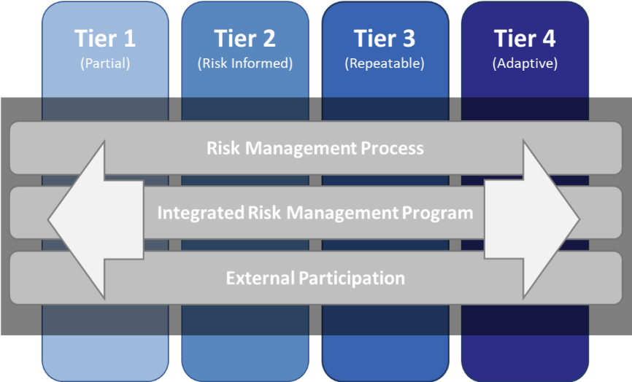
Framework Implementation Tiers
The Framework Implementation Tiers (“Tiers”) provide how an organization views cybersecurity risk and the processes in place to manage that risk
Ranging from Partial (Tier 1) to Adaptive (Tier 4), Tiers describe an increasing degree of rigor and sophistication in cybersecurity risk management practices.

Slide 46
Tier 1 (PartIal)

Slide 47
Risk Management Process
Organizational cybersecurity risk management practices are not formalized,
and risk is managed in an ad hoc and sometimes reactive manner.
Prioritization of cybersecurity activities may not be directly informed by organizational risk objectives, the threat environment, or business/mission requirements.

Slide 48
Integrated Risk Management Program
There is limited awareness of cybersecurity risk at the organizational level. The organization implements cybersecurity risk management on an irregular, case-by-case basis due to varied experience or information gained from outside sources. The organization may not have processes that enable cybersecurity information to be shared within the organization.

Slide 49
External Participation
The organization does not understand its role in the larger ecosystem with respect to either its dependencies or dependents. The organization does not collaborate with or receive information (e.g., threat intelligence, best practices, technologies) from other entities (e.g., buyers, suppliers, dependencies, dependents, ISAOs, researchers, governments), nor does it share information. The organization is generally unaware of the cyber supply chain risks of the products and services it provides and that it uses.

Slide 50
Tier 2 (Risk Informed)

Slide 51
Risk Management Process
Risk management practices are approved by management but may not be established as organizational-wide policy. Prioritization of cybersecurity activities and protection needs is directly informed by organizational risk objectives, the threat environment, or business/mission requirements.

Slide 52
Integrated Risk Management Program
There is an awareness of cybersecurity risk at the organizational level, but an organization-wide approach to managing cybersecurity risk has not been established. Cybersecurity information is shared within the organization on an informal basis. Consideration of cybersecurity in organizational objectives and programs may occur at some but not all levels of the organization. Cyber risk assessment of organizational and external assets occurs, but is not typically repeatable or reoccurring.

Slide 53
External Participation
Generally, the organization understands its role in the larger ecosystem with respect to either its own dependencies or dependents, but not both. The organization collaborates with and receives some information from other entities and generates some of its own information, but may not share information with others. Additionally, the organization is aware of the cyber supply chain risks associated with the products and services it provides and uses, but does not act consistently or formally upon those risks.

Slide 54
Tier 3 (Repeatable)

Slide 55
Risk Management Process
The organization’s risk management practices are formally approved and expressed as policy. Organizational cybersecurity practices are regularly updated based on the application of risk management processes to changes in business/mission requirements and a changing threat and technology landscape

Slide 56
Integrated Risk Management Program
There is an organization-wide approach to manage cybersecurity risk. Risk-informed policies, processes, and procedures are defined, implemented as intended, and reviewed. Consistent methods are in place to respond effectively to changes in risk. Personnel possess the knowledge and skills to perform their appointed roles and responsibilities. The organization consistently and accurately monitors cybersecurity risk of organizational assets. Senior cybersecurity and non-cybersecurity executives communicate regularly regarding cybersecurity risk. Senior executives ensure consideration of cybersecurity through all lines of operation in the organization

Slide 57
External Participation
The organization understands its role, dependencies, and dependents in the larger ecosystem and may contribute to the community’s broader understanding of risks. It collaborates with and receives information from other entities regularly that complements internally generated information, and shares information with other entities. The organization is aware of the cyber supply chain risks associated with the products and services it provides and that it uses. Additionally, it usually acts formally upon those risks, including mechanisms such as written agreements to communicate baseline requirements, governance structures (e.g., risk councils), and policy implementation and monitoring.

Slide 58
Tier 4 (Adaptive)

Slide 59
Risk Management Process
The organization adapts its cybersecurity practices based on previous and current cybersecurity activities, including lessons learned and predictive indicators. Through a process of continuous improvement incorporating advanced cybersecurity technologies and practices, the organization actively adapts to a changing threat and technology landscape and responds in a timely and effective manner to evolving, sophisticated threats.

Slide 60
Integrated Risk Management Program
There is an organization-wide approach to managing cybersecurity risk that uses risk-informed policies, processes, and procedures to address potential cybersecurity events. The relationship between cybersecurity risk and organizational objectives is clearly understood and considered when making decisions. Senior executives monitor cybersecurity risk in the same context as financial risk and other organizational risks. The organizational budget is based on an understanding of the current and predicted risk environment and risk tolerance. Business units implement executive vision and analyze system-level risks in the context of the organizational risk tolerances. Cybersecurity risk management is part of the organizational culture and evolves from an awareness of previous activities and continuous awareness of activities on their systems and networks. The organization can quickly and efficiently account for changes to business/mission objectives in how risk is approached and communicated.

Slide 61
External Participation
The organization understands its role, dependencies, and dependents in the larger ecosystem and contributes to the community’s broader understanding of risks. It receives, generates, and reviews prioritized information that informs continuous analysis of its risks as the threat and technology landscapes evolve. The organization shares that information internally and externally with other collaborators. The organization uses real-time or near real-time information to understand and consistently act upon cyber supply chain risks associated with the products and services it provides and that it uses. Additionally, it communicates proactively, using formal (e.g. agreements) and informal mechanisms to develop and maintain strong supply chain relationships.

Slide 62
Framework Profiles

Slide 63
Framework Profiles
The Framework Profile (“Profile”) is the alignment of the Functions, Categories, and Subcategories with the business requirements, risk tolerance, and resources of the organization. A Profile enables organizations to establish a roadmap for reducing cybersecurity risk that is well aligned with organizational and sector goals, considers legal/regulatory requirements and industry best practices, and reflects risk management priorities. Given the complexity of many organizations, they may choose to have multiple profiles, aligned with particular components and recognizing their individual needs.

